Slide 1
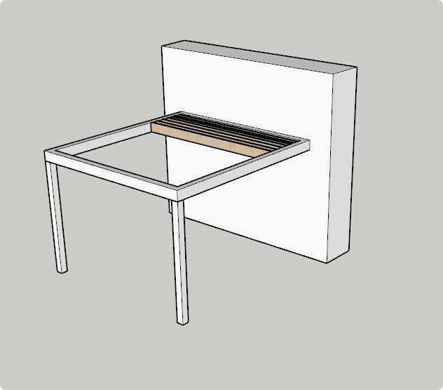
2-Pillar Wall Mounted Pergola
Retractable Pergola
Installation Manual

Slide 2
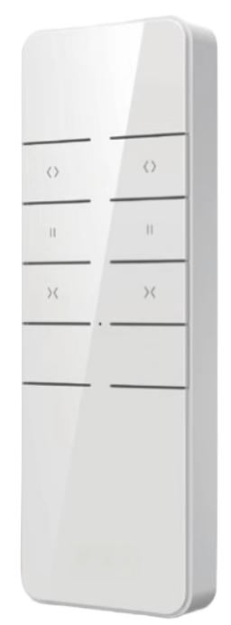
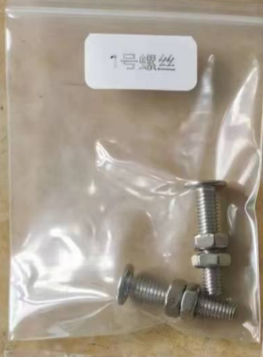
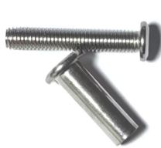
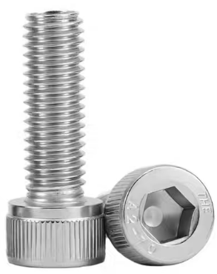
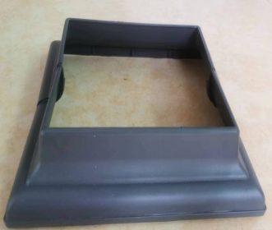
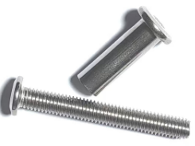
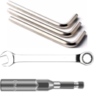
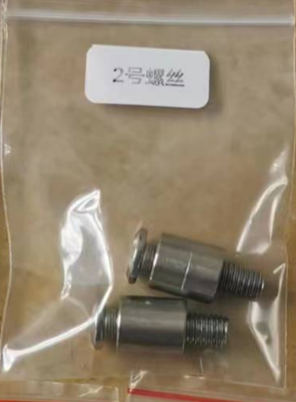
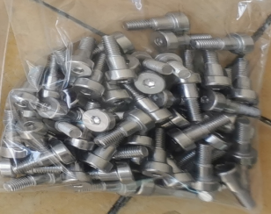
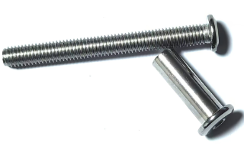
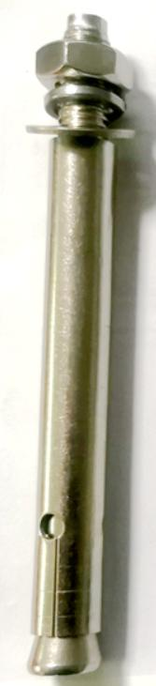
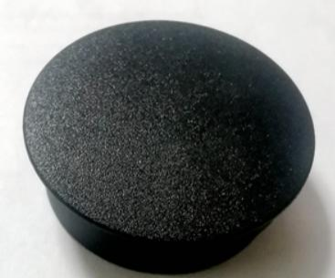
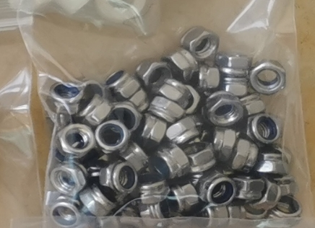
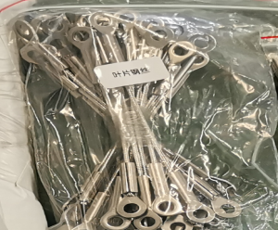
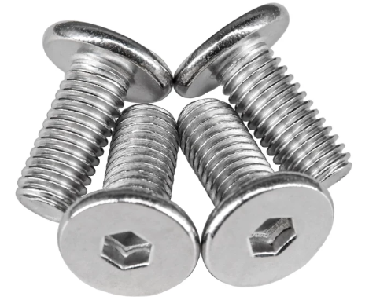
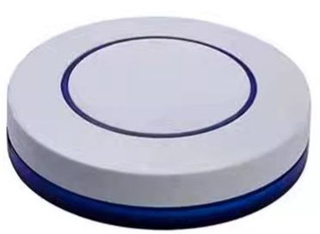
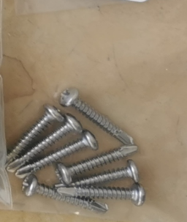
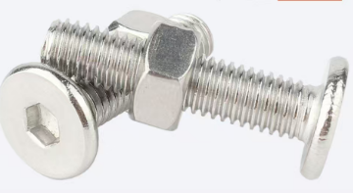
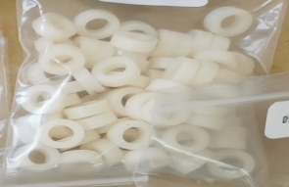
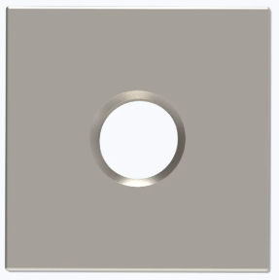
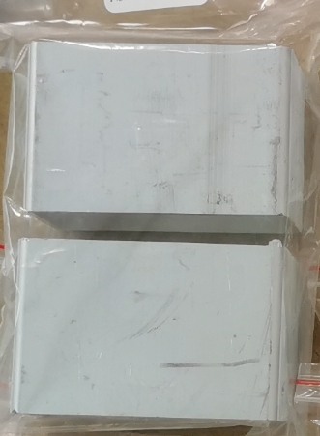
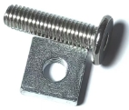
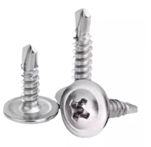
Remote Control |  |  | #1 |  |  | #4-1 |  |  | #6 |  |  | Pillar Foot Cover
 |  |  |  |  |  | #4-2
Hand Screw Tools |  |  | #2 |  |  |  |  |  | #7 |  |  | #9 | for wall mount and capping
 |  |  |  |  |  | #4-3
LED Light Controller |  |  | #3 |  |  | #5 |  |  | Chain wire |  |  | #10
Aluminium Block |  |  | #4 |  |  | #5-1 |  |  | #8 | for pillar foot |  | SCREW TABLE

Slide 3
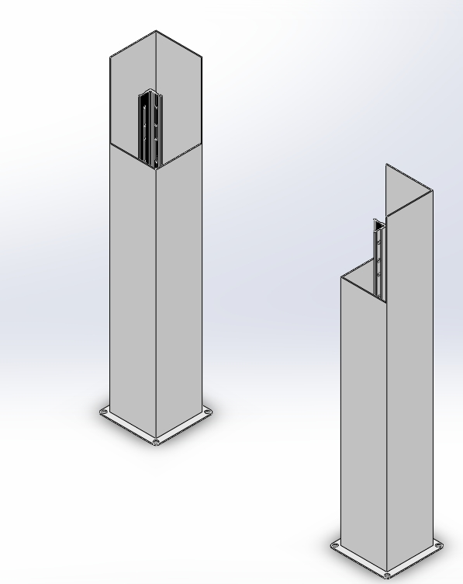
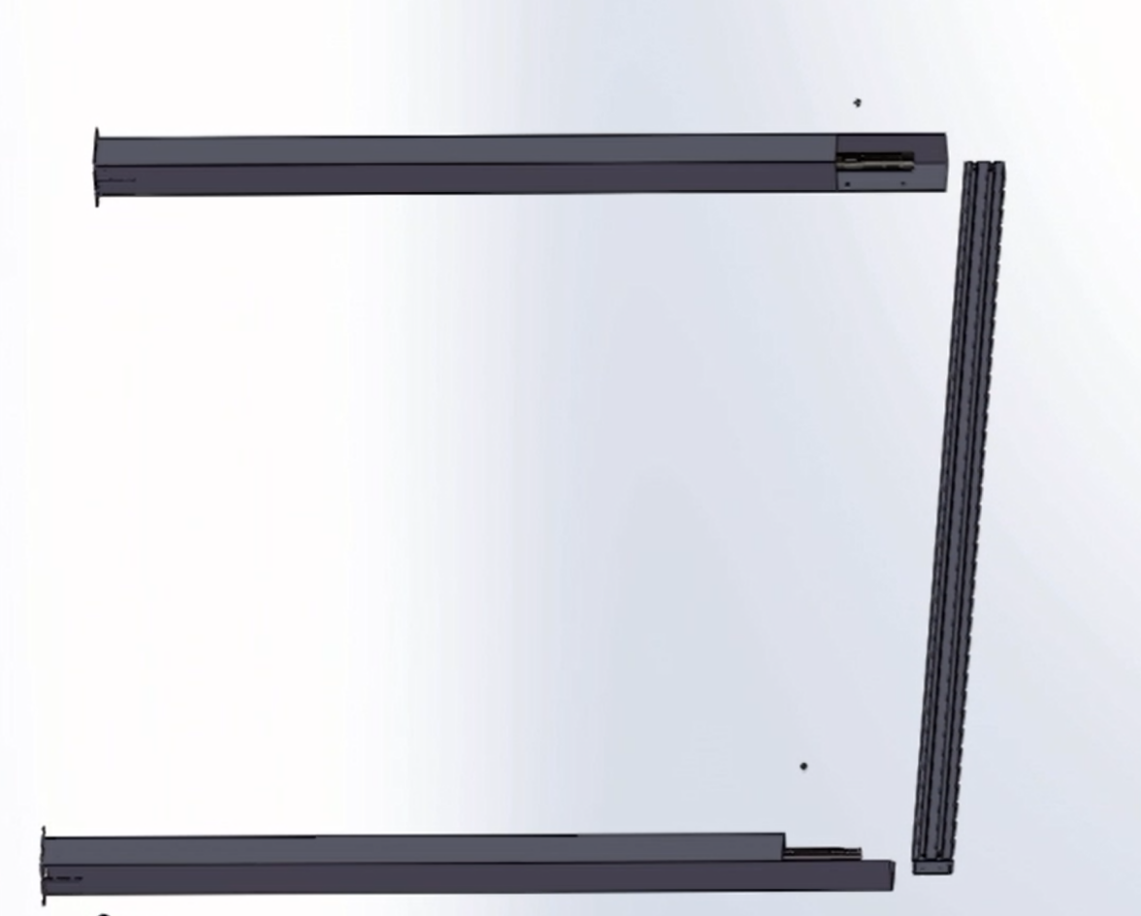
1. Pillar Position .
The main post (pillar) have been installed at the factory.
Firstly , position where are the motor side and place to two pillars in the right direction.
# 4 screw
Motor
Pillar B
Pillar A
On the job site, it only needs to be laid down on floor and secured with all beams.

Slide 4
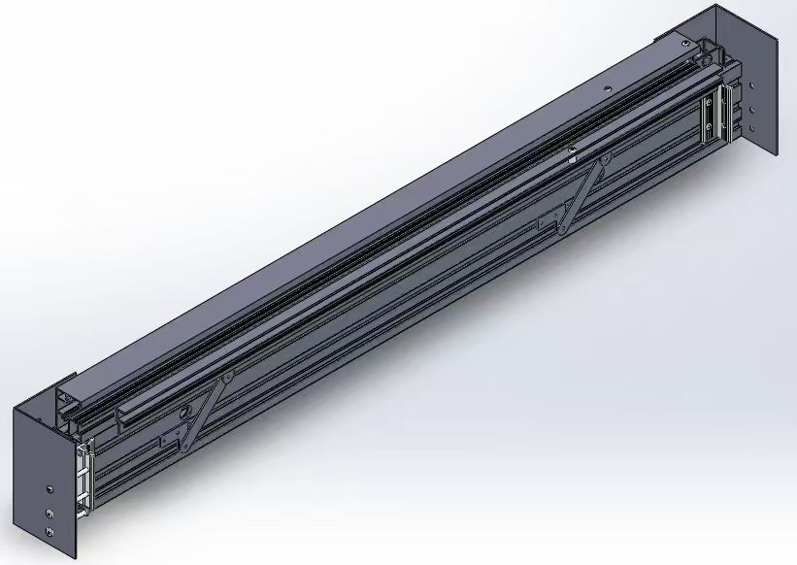
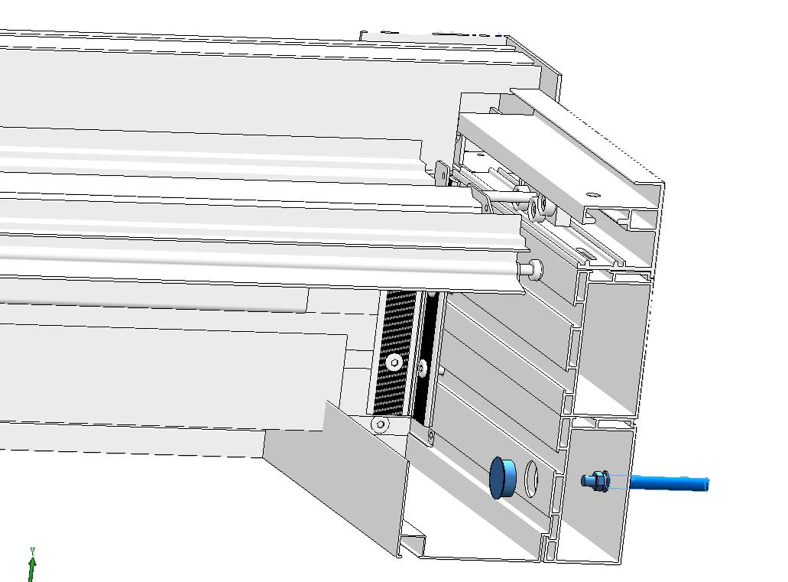
2. Installation of Wall-Mounted Beam.
Please secure the beam against the wall with screws,
then finish it with plastic screw caps.
#9 for wall mount bolt and capping
Pre-drilled holes have been provided for fastening.

Slide 5
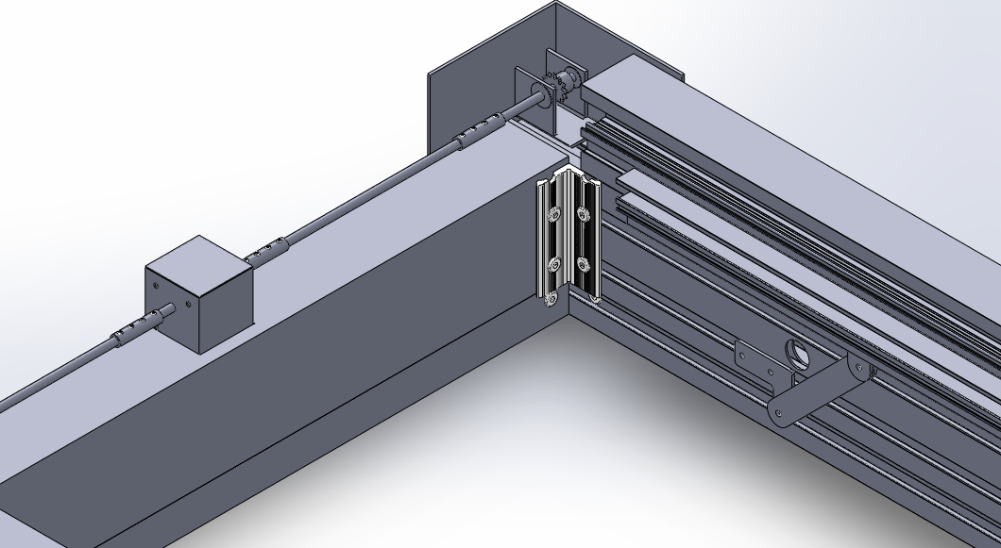
3. Screw fixed the beam and pillars by using #4-1, #4-2, #4-3 screws.
Only two parts here (close to the motor beam)
are used #4-3 srews.
The upper two holes are used #4-2 screws.
Motor
Pillar B
Pillar A
The 3rd holes are used #4-1 screws.

Slide 6
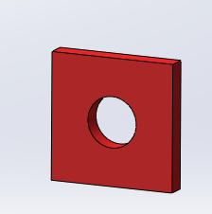
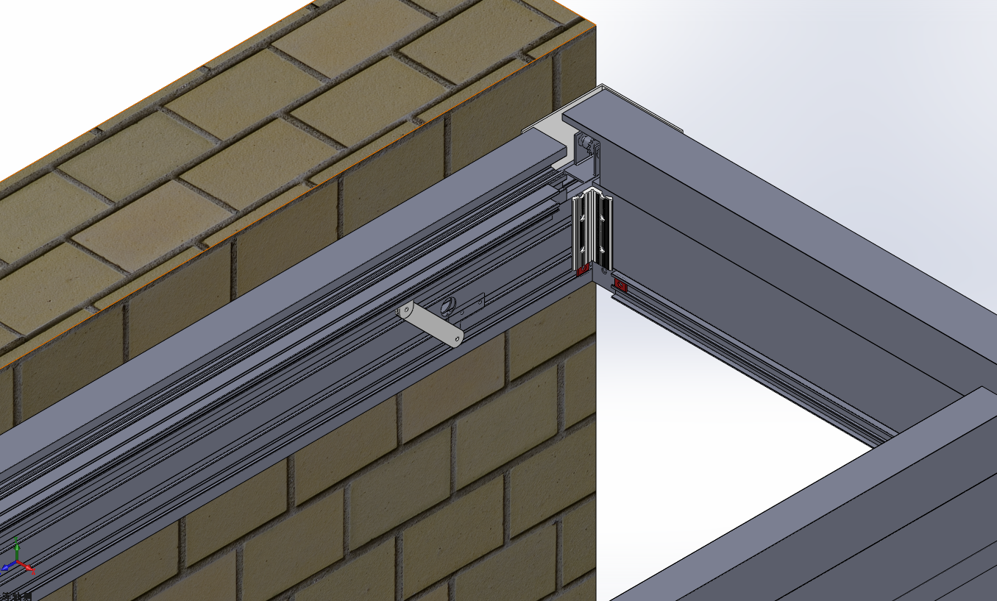
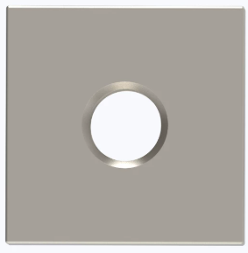
4. -1,Load Water Gutter (sink).
Insert the square nuts into the frame slot before installing the frame.
10# screw nuts

Slide 7
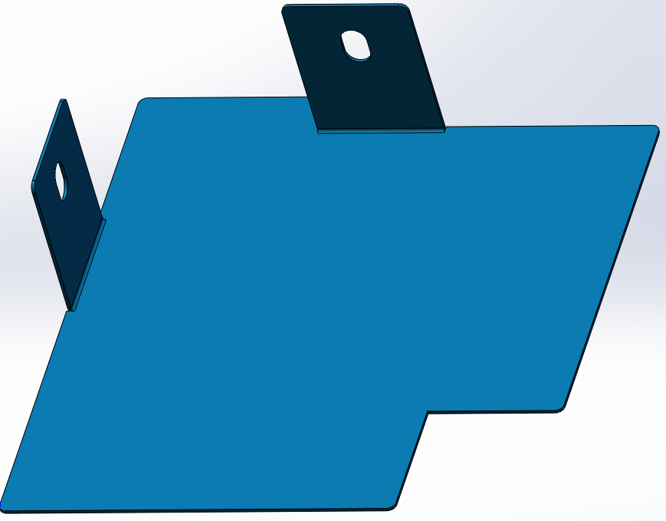
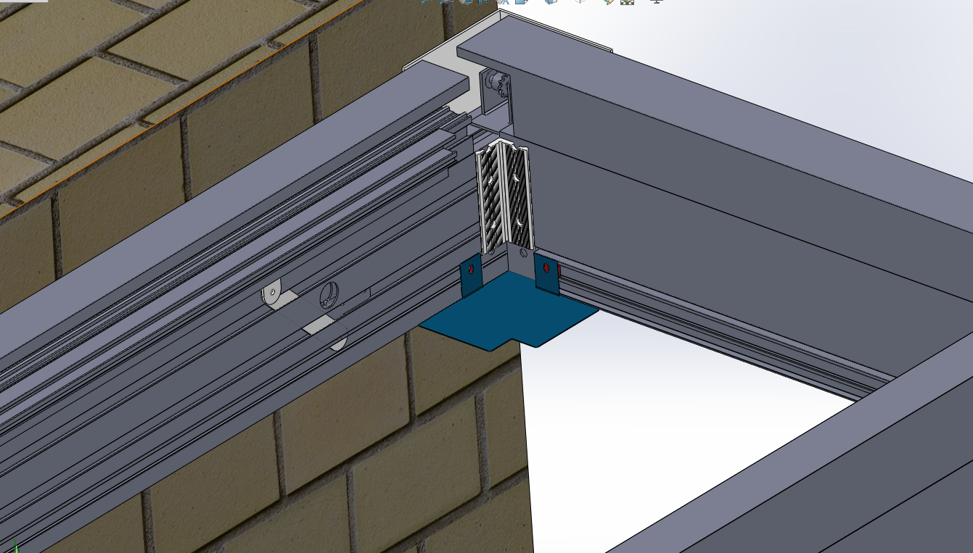
4.-2, Load Water Gutter (sink).
Insert the sink baffle.
(the baffles at different positions are labeled with letters)
Then secure it with one #10 screw.

Slide 8
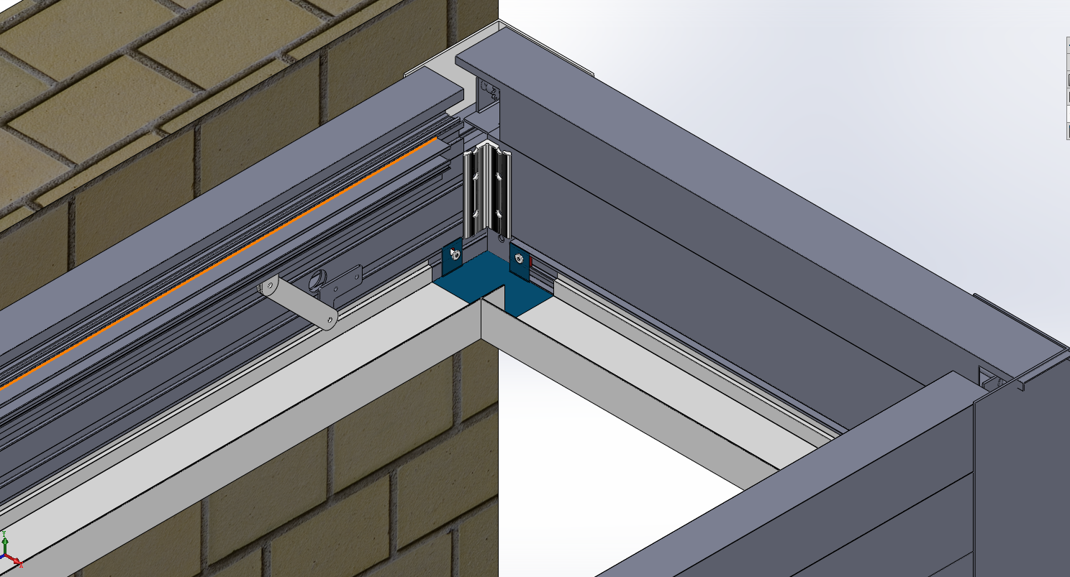
4.-3, Load Water Gutter (sink).
Load water gutter (the Sink) along four beams.

Slide 9
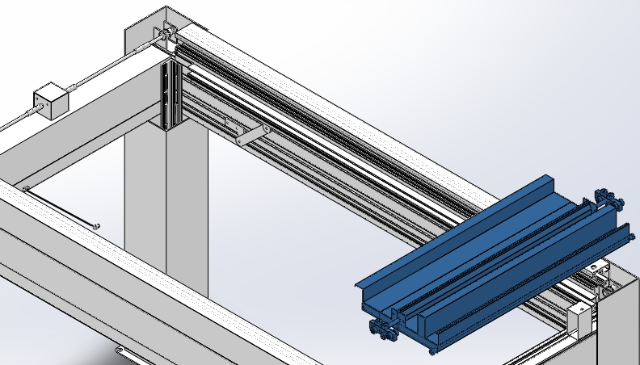
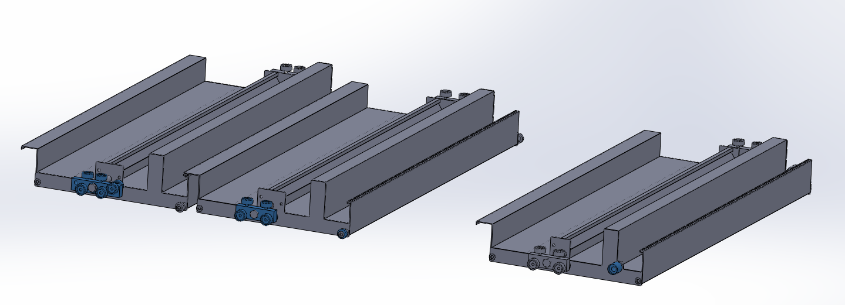
5. Load 1st Blade on top.
The 1st blade is labeled with marking.
other blades
Step ①
1st blade
Step ②
Note!
Make sure you find out the 1st blade .
It is different from other Blades.
Load the 1st blade from this gap, and slide to motor side.
Then load the 2nd,3rd blade......until the 2nd-to last.

Slide 10
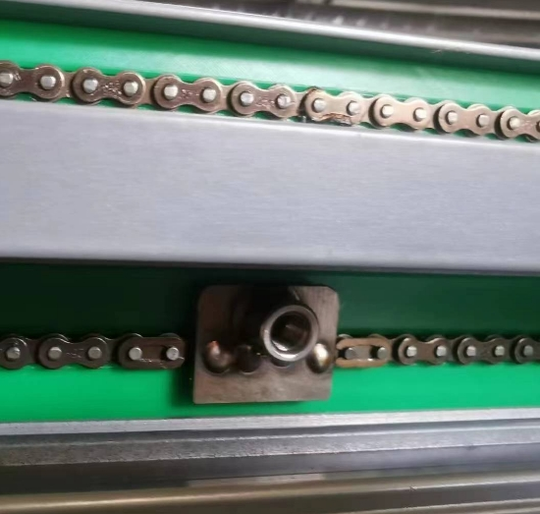
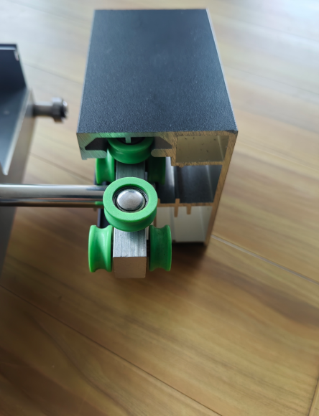
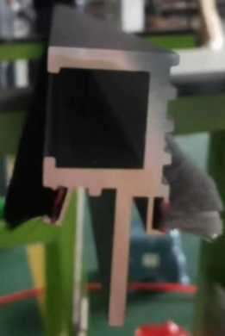
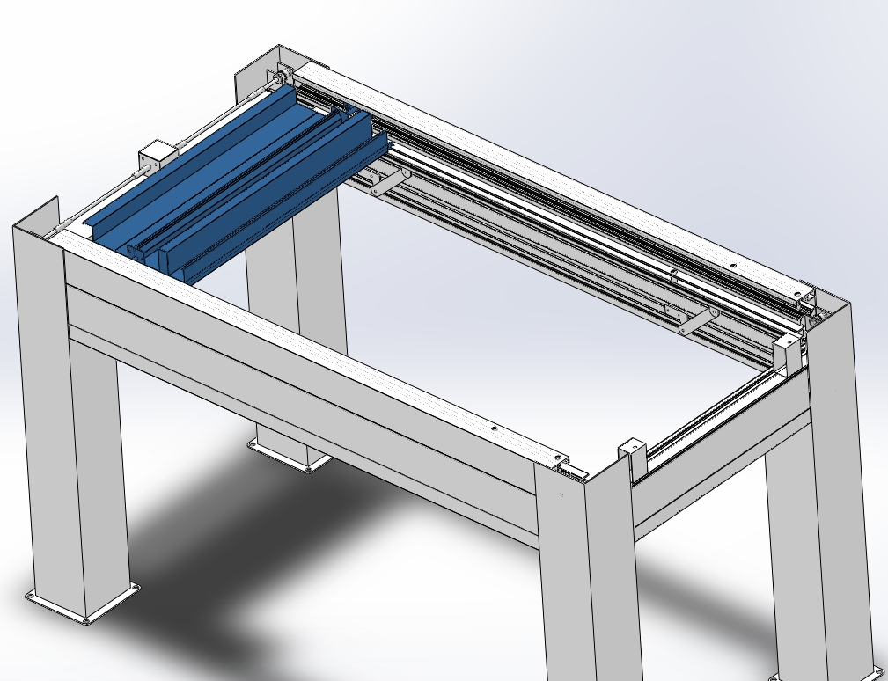
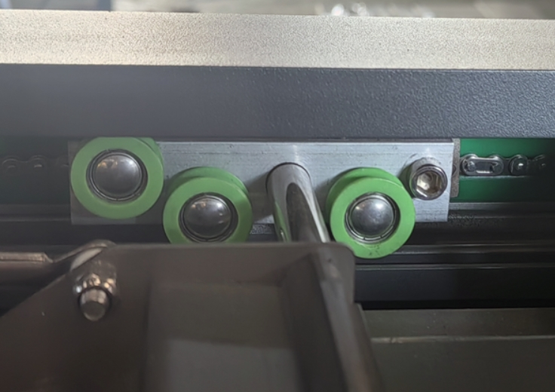
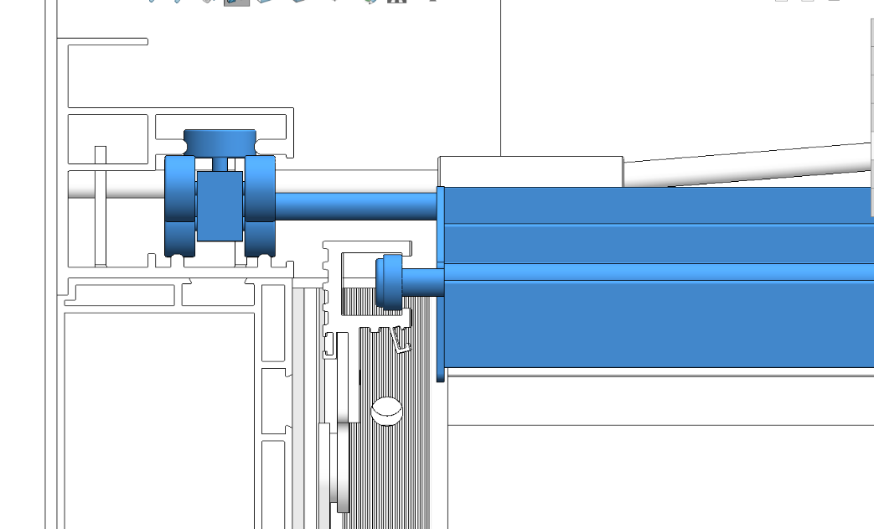
6. Use the 6# screw to tightly fix the rail together.
Check!
Every blades on two side has rollers. Make usre it goes into the U-groove.
6# screw here.

Slide 11
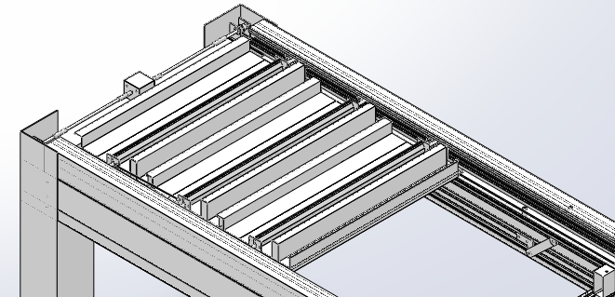
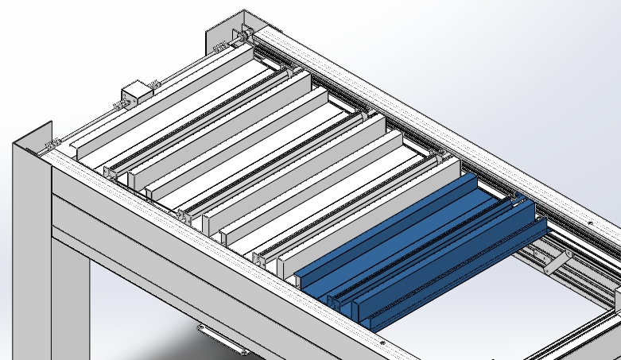
7. Install 2# screw, before you load the 2nd-to-last blade.
Put 2# screw first，then load the second-to-last blade .
2nd-to-last blade

Slide 12
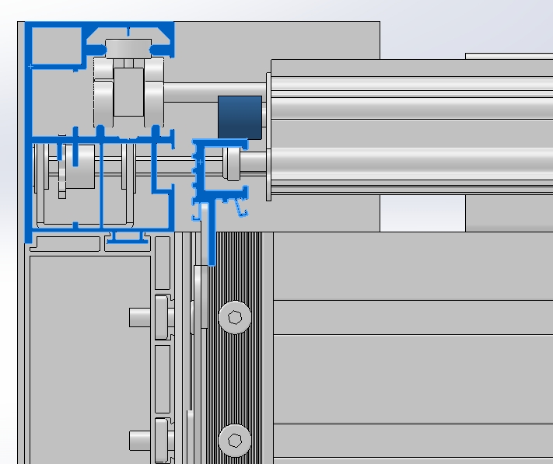
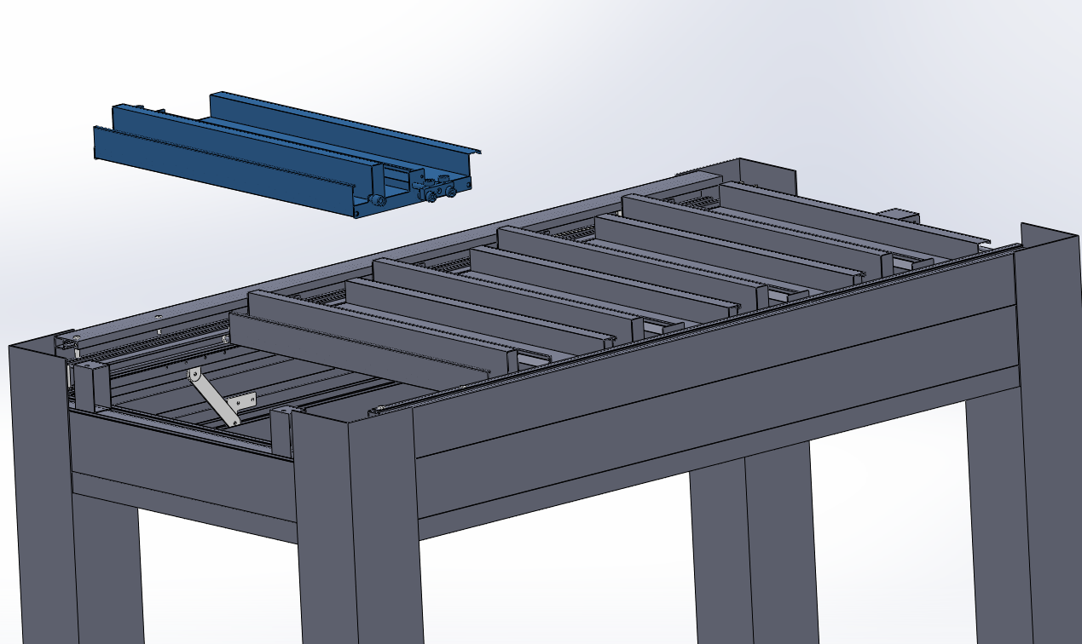
8. Load the last Blades.
Only the last blade roller head is above the U-groove.
the last blade
U-groove

Slide 13
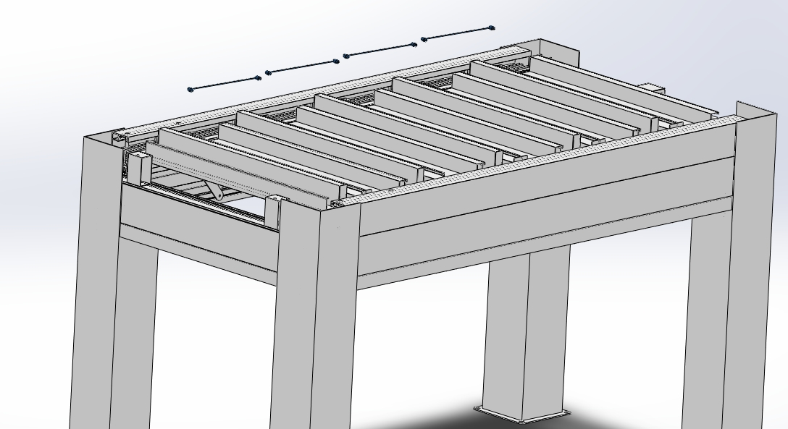
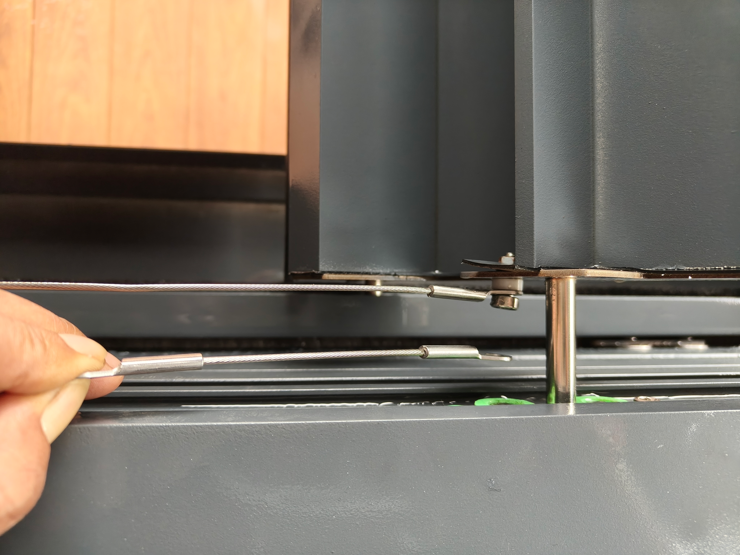
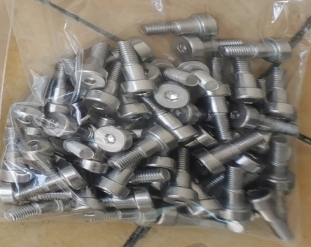
9.Link the Rail Chain by #7 Screws and steel wire ring .
Chain wire
Blade
√
# 7 screw
×
Beam
*Please ensure that all steel rings are facing the beam to prevent any jamming.

Slide 14



Note:
The control box is waterproof and low-voltage.
After connecting the power, straighten the cables and place the box inside the sink frame.
Once the wires are straightened, they are normally routed through the pillar to the inverter and power supply.
Please connect and power it according to the actual on-site conditions.
10. Assembling the LED Light
Step ① The LED light strip has been pre-installed. Simply connect the male and female connectors to form a square shape.
Step ② One of the ports must be connected to the controller using the corresponding male or female connector.
Female connector
Male connector
Step ③ Connect motor with Control Box.

Slide 15

11. After installing all the blades, use 1#, 3# screws fixing.
1# screws
3# screws
Use #1， #3 to screws fix the
beam cover on top.

Slide 16




12. Screw fix the block on top of the beam.
Step ②
Lock up the motor parts here on two ends.
Motor
Motor
Step ③
#5-1
#5
aluminium block
then use #5-1 to screws fix the
2nd beam cover (with brush strip).
Load two pieces aluminium block at opposite side of the motor ,by using one 5# screws and fix it.
Step ④
Put the motor cover on top.
Step ①

Slide 17

13. Pillar Foot Cover.
150X150mm
pillar foot cover
Motor
#8 pillar screw
Pillar A
Pillar B
Pillar Cover: The cover is a combination of two halves that are interlocked and fastened onto the column.

Slide 18


14. Power Supply: Link the power line from the indoor power supply to the pergola.
Motor with Line goes throught the pillar down to the floor (or from the beam).
There is a gap on the pillar bottom(or beam corner) ,allowing the line goes through.
24V safety Motor
Motor and control box
control box
Then goes through to the room connected with inverter (we provide),
then with a plug.
Motor: 24V
LED Lights: 12V
We will provide an inverter.
Usually put inside the room and with socket.

Slide 19
Ready Now! Precautions for the first power-on.
This motor does not require any debugging or testing before operation.
*Pay attention to the operation of the blade running when first time powered on.
If there is any obstruction, immediately turn off the power and check if any objects are stuck in the blades or U-groove.
Please note that when initially powered on, the motor will automatically move the blades back and forth once as its self-learning. During this process, do not press the remote control; it must complete one full way of automatic operation. After that, you use with remote control freely.
Contact us at any time and we are ready to help.

